Slide 1
Data Normalization
Avoiding Anomalies

Slide 2
Logical Data Model
This lecture concentrates upon building a ‘robust’ Logical Data Model. i.e.:
Transforming a Conceptual Data Model into a set of Relations using Normalization.
Checking these Relations for any Anomalies.
Documenting them as a Database Schema.

Slide 3
Some Terms ...
Don’t confuse with “Relationship”
Conceptual Term | Logical Term | Physical Term
Class or Class | Relation A set of tuples 2 Dimensions Tuples / Attributes | Table
 | Tuple A set of attribute values | Record or Row

Slide 4
What is Normalization?
The technique used to produce a set of relations with certain properties.
Properties which try to avoid certain known issues called “Anomalies”
Notes:
Database normalization is a process of organising fields and tables to produce a set of relations and minimise dependency

Slide 5
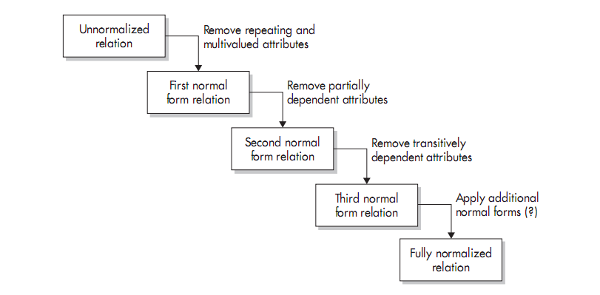
Overview of Normalization Process

Slide 6
What is an anomaly?
Anything we try to do with a database that leads to unexpected and/or unpredictable results.
Three types of Anomaly to guard against:
Insert
Delete
Update

Slide 7
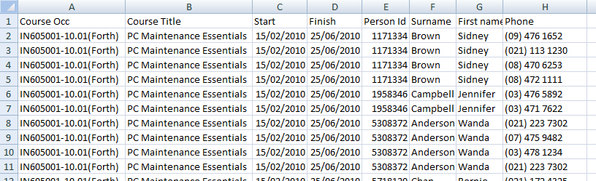
Consider this database
Student Database
Separate tuples for each phone number per person

Slide 8
Insert Anomaly
Cannot insert a new tuple because of an artificial dependency on another relation
In example – cannot enter “Bill Watts” phone number because he is not currently enrolled in a course
Usually happens because attributes of two Classes are mixed in the same relation.

Slide 9
Deletion Anomaly
Removal of one set of data removes other related data
If Wanda is ONLY taking IN605 in the first semester of 2020 - and we remove this course
then removing the course removes our record of her phone number.

Slide 10
Update Anomaly
Updating a single data value requires multiple tuple updates
Example:
The course dates change for IN605
Worse – possibility that not all values are changed – inconsistent data is a Bad Thing

Slide 11

Normalization Process
Lets begin with a conceptual model.

Slide 12
Translation – An Initial Attempt
Classes become Relations
Attributes become Attributes or Fields
Some key Attribute(s) become Primary Key(s)
Relationships are represented by additional Foreign Key Attributes linking tables
A “many” cardinality might end up with multiple valued attributes ... That’s ok just now
Notes:
One of the reasons for, and consequences of this subjectivity is that there is no right answer
Different people will produce different models

Slide 13
First Normal Form 1NF
First normal form is when there are no multi-valued attributes
No “Tables within Tables”
NOT 1NF
Customer ID | First Name | Surname | Telephone Number
123 | Robert | Ingram | 555-861-2025
456 | Jane | Wright | 555-403-1659 555-776-4100
789 | Maria | Fernandez | 555-808-9633
Table from http://en.wikipedia.org/wiki/First_normal_form

Slide 14
Don’t Cheat with Null-ible Fields
One way to overcome this, especially for phone numbers, is to allow extra fields with nulls
This is NOT 1NF – each field should be unique domain
Customer ID | First Name | Surname | Tel. No. 1 | Tel. No. 2 | Tel. No. 3
123 | Robert | Ingram | 555-861-2025
456 | Jane | Wright | 555-403-1659 | 555-776-4100
789 | Maria | Fernandez | 555-808-9633
Table from http://en.wikipedia.org/wiki/First_normal_form

Slide 15
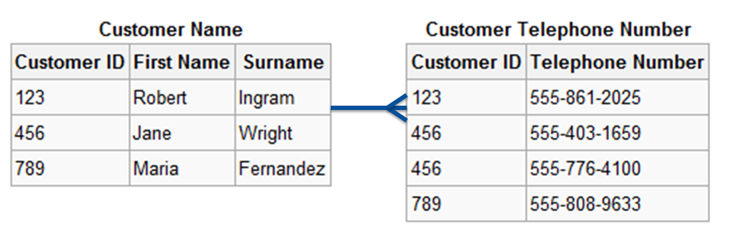
Correct 1NF Solution
Notes:
Look at the Cardinality , one customer can have many phone numbers, but many phone numbers must have one customer

Slide 16
General Approach
When you identify a multi-valued field in a relation:
Create a new relation with a meaningful name
Existing relation becomes a Foreign Key (FK) in the new relation
Move the multi-values from the first relation into the new relation – one value per tuple
The primary key for the new relation may be all attributes – that’s fine, providing the combination will be guaranteed unique
Or you can make a surrogate Primary Key if needed.

Slide 17
Background to Second Normal Form (2NF)
Before you can understand Second Normal Form, you have to understand “Functional Dependency”

Slide 18
Functional Dependent
A value is functionally dependent on another value if it always is identified by it.
All values in a database are functionally dependent on the primary key
To find my address, find my staff-ID in the HR database
If an attribute B is unique for each value of A then you could say that B is functionally dependent on A
i.e. if you find out value A then you will have only one value B

Slide 19
Functional Dependency Anecdotal Examples
There is a functional dependency between a staff member and office
If you identify a staff member you can find their office
BUT finding an office doesn’t necessarily identify a unique staff member
FD between a person and their Date of Birth
But not between any date and a particular person
Notes:
e.g. Look up Paul Aadmiral you’ll find the office D316
But if you look up D316 you’ll find two or three people
Staff → Office
Office NOT-FD Staff

Slide 20
Notation
Functional Dependency may be stated as:
X → Y
Meaning X defines Y,
Or in other words:
if you know X then you know Y
Staff → Office
Office NOT-FD Staff

Slide 21
Second Normal Form 2NF
A relation is in Second Normal Form if and only if
The relation is in First Normal Form AND
Any attribute that is not part of a primary key is functionally dependant on the entire primary key.
Or to put it another way (a little looser)
We need all the fields in the key to determine the values of the non-key fields.

Slide 22
Fails 2NF: Employees Skills Relation
Employee | Skill | Current Work Location
Jones | Typing | 114 Main Street
Jones | Shorthand | 114 Main Street
Jones | Whittling | 114 Main Street
Bravo | Light Cleaning | 73 Industrial Way
Ellis | Alchemy | 73 Industrial Way
Ellis | Juggling | 73 Industrial Way
Harrison | Light Cleaning | 73 Industrial Way
Table from http://en.wikipedia.org/wiki/Second_normal_form
Notes:
Employee AND skill must be the PK
BUT
Employee (by itself) will give you a unique “current work location”
You don’t need the WHOLE key to find the “Current work location” therefore it’s not 2nf

Slide 23
Consider this
What are the functional dependencies here?
What is the primary key?
What attribute (or set of attributes) is unique for each tuple?
Is there any attribute which is functionally dependent on only part of the primary key?
I.e. does any part of the PK uniquely identify a field?

Slide 24
Decomposing tables to 2NF
Failing 2NF often means you have mixed domains (in this case employee and skill)
And probably part of that mix involves the primary key.
Identify which attributes belong together
Create a relation of those
Move the others to another relation using a foreign key to reference the main relation

Slide 25
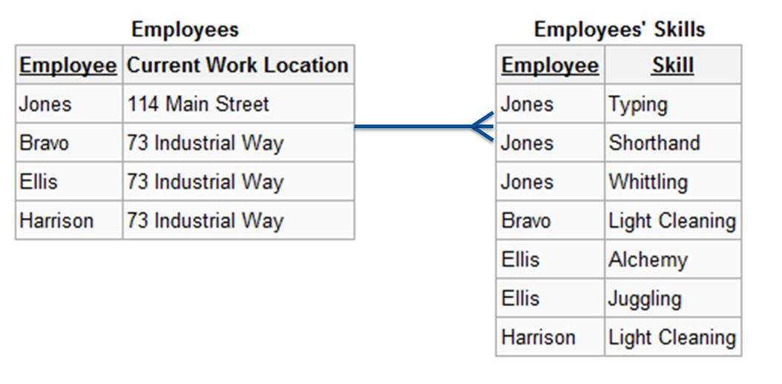
Solution to Employee Problem

Slide 26
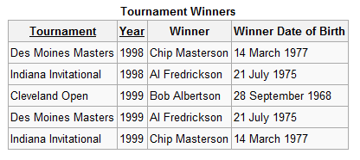
2NF Protection from anomalies?
Check this relation. Is it in 2NF?
Anomalies:
Insert?
Deletion?
Update?
http://en.wikipedia.org/wiki/Second_normal_form
Notes:
Insertion anomaly: can’t insert Bob Brown as winner of the Cleveland Open 2001 if you don’t know his DoB
Deletion anomaly: If the Cleveland Open 1999 is deleted we loose information about Bob Albertson’s dob
Update anomaly: If we realise that Chip’s birthday was 14 April we need to update it multiple places or end up with inconsistancies

Slide 27
Third Normal Form
Relation is in Second Normal Form
No Transitive Dependencies

Slide 28
Transitive Dependency
An attribute has a transitive dependency if you can get to it through another
X defines Y
Y defines Z
Therefore we have a transitive dependency where if we know X then we know Z

Slide 29
Nothing But the Key
Every non-key attribute "must provide a fact about the key, the whole key, and nothing but the key.
Kent, W. (1983). A Simple Guide to Five Normal Forms in Relational Database Theory, Communications of the ACM 26 (2), pp. 120-125.
All non-key attributes depend only on the primary key
If there’s a non-key field which uniquely identifies another attribute then not 3NF
Notes:
A key should identify an attribute
A non-key attribute should NOT identify another attribute

Slide 30
Identifying Transitive Dependencies
Look at your table and see if any columns would require updating if another column in the table was updated.
If such a column exists, it probably violates 3NF.

Slide 31
Transitive Dependencies
Primary Key (PK) | Column A | Column B | Transitive Dependence?
PersonID | FirstName | LastName | No, In Western cultures a person’s last name is based on their father’s LastName, whereas their FirstName is given to them.
PersonID | BodyMassIndex | IsOverweight | Yes, BMI over 25 is considered overweight.It wouldn’t make sense to have the value IsOverweight be true when the BodyMassIndex was < 25.
PersonID | Weight | Gender | No:There is no direct link between the weight of a person and their sex.
VehicleID | Model | Manufacturer | Yes:Manufacturers make specific models. For instance, Ford creates the Fiesta; whereas, Toyota manufacturers the Camry.

Slide 32
Remember this? What are the dependencies
http://en.wikipedia.org/wiki/Third_normal_form
Notes:
If winner changes (non-key attribute) – need to update winner dob (another non-key attribute)

Slide 33
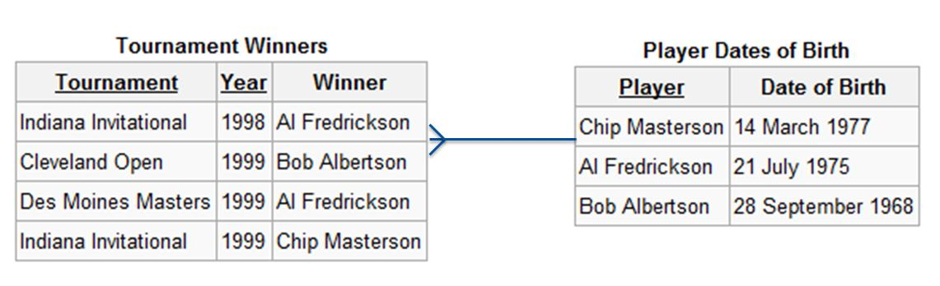
Decompose by moving dependency

Slide 34
Don’t change Conceptual Model
Your conceptual model represents the data within the business
The logical model targets the database type – we have looked at relational databases.
Other types (object oriented, hierarchical) have different constraints and will have a different logical model
Notes:
18
18

Slide 35
Read
Chapter 8 – Churcher.
PDF on I:\ drive: simple-guide-to-five-normal-forms-in-relational-database-theory.1
Normalisation Exercises.

